Slide 1
Linux: Ch. 5.6.3; Ch 21.1-21.9
Bovet & Cesati (2001) Understanding the Linux Kernel. O’Reilly.
Linux knowledge base and tutorial
  http://www.linux-tutorial.info/
Writing device drivers in Linux: A brief tutorial
  http://www.freesoftwaremagazine.com/articles/drivers_linux
How to compile the Linux kernel
  http://www.linuxplanet.com/linuxplanet/tutorials/202/1/
Linux documentation project
  http://www.tldp.org/
  E.g., Kernel module programming guide
    http://www.tldp.org/LDP/lkmpg/2.6/html/index.html
Linux CPU Scheduler (Josh Aas, 2005)
  http://josh.trancesoftware.com/linux/linux_cpu_scheduler.pdf
The Linux Kernel Primer (2006), C. Salzbert Rodriguez, G. Fischer, S. Smolski. Prentice Hall.

Slide 2
Overview
Linux system
  Kernel, system, distribution
  Characteristics & goals
  Kernel modules
Ch 21.4: Process management
Ch 21.5: CPU Scheduling, SMP, Interrupt handling
Ch. 21.9: Interprocess Communication
Ch 21.6: Memory management
Ch 21.7: File Systems
Ch 21.8: Input and Output

Slide 3
Linux
Kernel
  Includes process management, memory management, device drivers, file systems, networking
  Version 0.01 (first release): May 14, 1991
  Textbook talks about Linux 2.6 kernel (late 2003)
  Latest stable Linux kernel (http://www.kernel.org/): 2.6.25.1 (as of 5/5/08)
System
  Includes various other components, such as network servers, web browsers, compilers, graphical user interface
Distribution
  Includes administrative tools to simplify installation and upgrading (e.g., Redhat, Ubuntu)
Licensing under GNU General Public License (GPL): “free software”
Notes:
First web browser around 1989: Tim Berners-Lee
Latest stable Linux kernel (http://www.kernel.org/): 2.6.20.6 (as of 4/13/07)

Slide 4
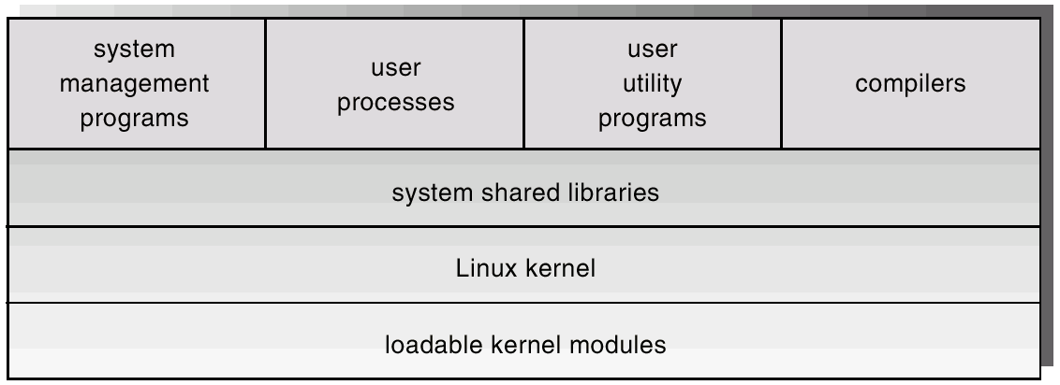
Components of Linux
Figure 21.1

Slide 5
General Characteristics & Goals
Multi-user, UNIX system
  Full set of Unix tools
Kernel
  Monolithic-- single address space containing all kernel functionality (not a microkernel)
  Modules
  Multi-tasking
  Preemptive: Processes can be preempted while running in kernel mode
Goals
  Speed, efficiency
    E.g., install on a system with relatively small amount of RAM & disk
      E.g., 4 MB RAM
  Compatibility & standardization (e.g., POSIX)
    “Even when the same system calls are present on two different UNIX systems, they do not necessarily behave in exactly the same way” (p. 724)

Slide 6
Kernel Modules
Arbitrary sections or components of kernel code
Run in kernel (privileged) mode
Full access to hardware capabilities & instructions
Modules can provide various capabilities
  E.g., device driver, file system format, network protocol, binary excutable file format
Kernel components (modules) can be dynamically loaded/unloaded
  But still a single kernel address space
Notes:
Explicit loading: e.g., at system startup

Slide 7
Explicit & Implicit
Module Loading/Unloading
Explicit
  System can be configured so particular drivers are loaded upon system startup
Implicit
  Can be loaded on demand and unloaded when not in use
  E.g., A CD-ROM driver might be loaded when a CD is mounted, and unloaded from memory when CD dismounted from file system
Module support under Linux
  Module management: Allows modules to be loaded into memory and to talk to rest of kernel
    Module is dynamic linked into running kernel; kernel has a dynamic symbol table to allow module access to kernel symbols
  Driver registration: Allows modules to tell rest of kernel that a new driver has become available
  Conflict-resolution mechanism: Allows different device drivers to reserve hardware resources

Slide 8
Process Management
Kernel support for both heavy-weight processes and threads
PCB (process descriptor; p. 82, Linux Kernel Primer)
  Process identity
    PID, credentials (user & group ID), personality (emulation libraries)
  Process environment
    Command line arguments; shell variables
  Process context (p. 750 text & p. 82, Linux Kernel Primer)
    Scheduling context (e.g., registers), including kernel stack
    Virtual memory context (region descriptions, page table)
    Open file table
    File system context
    Signal handler table
    Resource limits
Same PCB structure for all process types
  Thread shares some of data structures of parent
  Each PCB is just a series of pointers into kernel tables
Notes:
Logical address space: series of regions
No overlap between regions
Continuous sequence of pages of logical address space
E.g., regions for program text (code), data, stack

Slide 9
Process Control Blocks
User RAM
PCB1
PCB2
PCB3
Address space
Address space
Address space
Addr
space 1
Addr
space 2
Address space kernel table

Slide 10
Process Management - 2
System calls
  Fork, exec, clone
Linux doesn’t distinguish between processes and threads
  Uses the general term task
When a clone is invoked, it is passed a set of flags that determine how much sharing is to take place between parent and child tasks (see Table, p. 750)
Fork is just a special case of clone in which none of the process data is shared

Slide 11
CPU Scheduling (Ch. 5.6.3, 21.5)
Discussion is partly from 2.6.8.1 kernel CPU Scheduler (Aas, 2005)
Preemptive, priority-based algorithm
Multiple CPU process scheduling algorithms
  1) Time-sharing (“nice” scheduling)
    Fair
    SCHED_NORMAL
  2) Real-time (RT)
    Absolute priorities are more important than fairness
    SCHED_FIFO, SCHED_RR
Notes:
I went to a different source than the text for this because the textbook did not describe how Linux arbitrates between the real-time scheduling and the time-sharing scheduling

Slide 12
Priorities & Time “Quanta”
Numerically lower values indicate higher priorities
Real-time priority values: 0-99
  As long as there is a runnable real time (RT) task, no other tasks can run (Aas, 2005, p. 28)
Time-sharing (“nice”) priority values: 100-140
Variable time “quanta”
  Higher priority processes (e.g., real-time) are given longer time quanta
  E.g.,
    SCHED_RR, priority 0 given 200 ms
    Priority 140 given 10 ms
Notes:
I’ve quoted quanta here because the meaning of quanta is not exactly the same that we’ve enountered before: It’s not the amount of time a process is given each time it is dispatched to a CPU.

Slide 13
Linux Real-time Scheduling
SCHED_FIFO, SCHED_RR
Soft real-time scheduling
  Priority-based, not deadline-based
Each process has a priority & a scheduling class
  Scheduling classes:
    FCFS (first-come first-served)
    RR (round-robin)
Always runs highest priority process
  Among equal priority processes, runs one that has been waiting the longest
“FCFS” or “RR”
  “The … difference between FCFS and round-robin scheduling is that FCFS processes continue to run until they either exit or block, whereas a round-robin process will be preempted after [a time slice] and will be moved to the end of the scheduling queue” (p. 753, text)
  SCHED_FIFO (FCFS) processes do not have timeslices
Notes:
SCHED_RR processes have a simple timeslice (p. 28, Aas, 2005)
By “simple timeslice” mean a time slice in the usual sense of CPU scheduling

Slide 14
Time-Sharing Scheduler
SCHED_NORMAL
Tasks initially given a time quanta according to priority
Runnable tasks
  Those that have time remaining in their quanta
When a task exhausts its time quanta it has expired; otherwise it is active
  Expired tasks are not scheduled again until all other tasks have exhausted their individual time quanta’s
Two arrays of tasks in the runqueue
  Expired & active tasks
  Each have linked lists within priority number
When active array empty, swap with expired
Tasks time quanta’s replenished
Notes:
Seems like the term “time quanta” is used somewhat differently than we’ve seen it used already. A time quanta of time on the CPU seems like it is not given to each process each time. I’m assuming that if a process on Linux was to execute a system call or be interrupted in the middle of its time quanta, then when it resumes execution, it would use up the remainder of its time quanta.

Slide 15
SMP: Symmetric Multi-Processing
Linux 2.0
  Only one processor at a time could execute kernel code
  Implemented with a single busy wait semaphore (spinlock, see p. 202 of text)
  I.e., any other processes trying to gain access do a busy wait instead of blocking
Linux 2.2
  Multiple spinlocks in kernel
  Limited execution of kernel code by more than one processor
Linux 2.6
  Generally, multiple tasks/processors can be using the kernel

Slide 16
Ch 21.9 IPC: Interprocess Communication
Semaphore
  Can be used between heavy weight processes
Pipe
  Communication channel from parent to child
Sockets
Shared memory
  Between light weight processes (in same HWP)
  Between heavy weight processes
Message queues
Signals
  Asynchronous events (not data); used to inform a process that an event has occurred
  Sent by one user process to another or from kernel to a user process (e.g., to inform when a child dies)

Slide 17
Signals
Some signals can be handled (caught) by the process
  Handling takes the form of registering a signal handler
  Signal handlers are functions that get called when the signal occurs
Signal handling can be used to make a program more robust to certain conditions
  E.g., if you want to make sure to do some processing before terminating a process, handling a signal generated by a ^C is a good idea
Some signals cannot (e.g., SIGKILL, SIGSTOP) be handled by the process

Slide 18
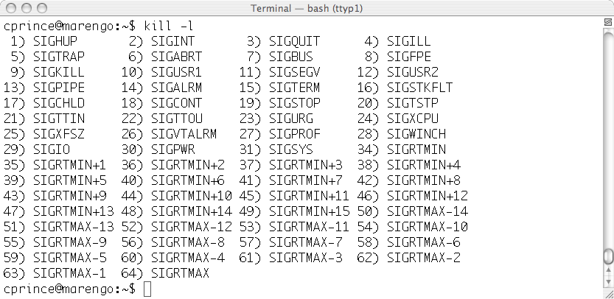
Signals
Notes:
Marengo, ubuntu, 2006 installation
cprince@marengo:~$ uname -a
Linux marengo 2.6.17-10-generic #2 SMP Tue Dec 5 22:28:26 UTC 2006 i686 GNU/Linux

Slide 19
Some Signal System Calls
int sigaction(int signum, const struct sigaction *act, struct sigaction *oldact);
// Examine and change a signal action
sighandler_t signal(int signum, sighandler_t handler);
// install a new signal handler (deprecated)
int pause(void); // wait for a signal
int kill(pid_t pid, int sig); // send a signal
unsigned int alarm(unsigned int seconds);
// arranges for a SIGALRM signal to be delivered
Notes:
See sigaction; linux signal is deprecated.

Slide 20
Signal Example:
Receiving Process
/* signal.c starts */
#include <signal.h>
#include <stdio.h>
#include <sys/types.h>
#include <unistd.h>
void handleSIGINT(int sig)
{
printf("received SIGINT (sig= %d)\n", sig);
fflush(stdout);
}
void handleSIGQUIT(int sig)
{
printf("received SIGQUIT (sig= %d)\n", sig);
fflush(stdout);
}
void handleSIGUSR1(int sig)
{
printf("received SIGUSR1 (sig= %d)\n", sig);
fflush(stdout);
}
void handleSIGTSTP(int sig)
{
printf("received SIGTSTP (sig= %d)\n", sig);
fflush(stdout);
}
void handleSIGFPE(int sig)
{
printf("received SIGFPE (sig= %d)\n", sig);
fflush(stdout);
}

Slide 21
Signal Example: Signals from Keyboard
$ ./signal
pid of handler process is: 2517
received SIGINT (sig= 2)
received SIGQUIT (sig= 3)
^C was typed here
^\ was typed here

Slide 22
Floaing Point Exceptions
Seems that instruction pointer doesn’t get advanced, so FPE happens repeatedly
  http://technopark02.blogspot.com/2005_10_01_archive.html
See also: http://ds9a.nl/fp/

Slide 23
Signal Example: Signals from another process - 1
#include <signal.h>
#include <stdio.h>
int main() {
int pid;
printf("Enter pid of process to send signal to: ");
scanf("%d", &pid);
kill(pid, SIGUSR1);
}

Slide 24
Signal Example: Signals from another process - 2
$ ./signal &
pid of handler process is: 2700
$ ./send
Enter pid of process to send signal to: 2700
received SIGUSR1 (sig= 10)

Slide 25
Ch. 21.6: Linux Memory Management
Internal kernel memory needs
  Kmalloc kernel allocator
  Slab allocator
  Buddy heap
Virtual memory
Notes:
static allocator seems to be kmalloc
kernel allocators seem to be buffer cache, and page cache
user process allocator seems to be the page allocator
regions can be comprised of contiguous sequences of frames, but it appears that not all regions of a user process are allocated in this manner

Slide 26
Kmalloc
Memory allocator used by kernel routines (e.g., interrupt handlers)
  E.g., they don’t use “new Object” calls in C++
  Need more explicit control over memory allocation
Allocates variable amounts of memory
  Analogous to malloc
  void *malloc(size_t size); // allocate size bytes of memory
Acquires entire frames, and then splits into smaller pieces
Allocates until explicitly freed; frames are locked and cannot be victimized

Slide 27
Slab Allocation
Use to allocate kernel data structures
  Slab: >= 1 physically contiguous frames
Cache
  Each cache: one or more slabs
  Single cache for each kernel data structure
    E.g., file objects, semaphores
  Cache populated with objects (e.g., semaphore objects)

Slide 28
Buddy heap
Used for allocation of contiguous regions
A kind of “best fit” algorithm
Emphasis on contiguous regions for reasons including
  a) DMA requires contiguous frames (doesn’t use MMU)
  b) Need contiguous pages for slabs
Free frames are maintained on lists of 1, 2, 4, 8, 16, 32, 64, 128, 256, 512 frames
Release operation tries to iteratively merge double sized regions
Notes:
Contiguous region argument: pp. 165, Bovet & Cesati (2001) Understanding the Linux Kernel. O’Reilly.

Slide 29
Virtual Memory
Pure demand paged virtual memory (p. 763)
LFU-type page replacement policy
  Form of clock algorithm
Copy-on-write mechanisms (e.g., fork)
Two separate views of a processes address space
  Set of regions
  Set of pages
Notes:
Reference counts for frames? Still have this with PTE lists?

Slide 30
Regions
Logical address space: series of regions
  No overlap between regions
  Continuous sequence of pages of logical address space
  E.g., regions for program text (code), data, stack
Information per region (vm_area_struct)
  Read, write, execute permissions for process
  Any files associated with region
  Table of function pointers for page management functions
  Region type
Region index structure (per process)
  Allows lookups of region by logical address
  Balanced binary tree
Notes:
Regarding content of regions being stack, program text, data-- see p. 763
Information per region (vm_area_struct)
Logical address range: start, end (see p. 199, Bovet & Cesati, 2001)

Slide 31
Region Types Defined By
Backing store
  “demand zero”
    When process first tries to access (read or write) page in region, a frame is allocated, entered into page table, and it is initialized with zeros
  File backing
    Virtual-memory page is a viewport onto page of the file contents
Reaction to writes
  Private: copy-on-write
    First write causes a new frame to be allocated, and contents copied prior to write
  Shared: frame is updated

Slide 32
Page Tables
Properties per page
  Physical memory frame, or location on swap disk if swapped out
  Resident or nonresident?
  Read only?
  Copy-on-write?
  Age
When page is accessed, but it is not resident:
  Lookup the region for the virtual address
  If needed (e.g., file backing region), the file is obtained for this page of the region
  Region page-management functions are called
    e.g., to bring the page in from disk
  Physical frame is allocated
  Page table updated
Notes:
Age of a page: indicated on p. 761 of text
It seems that MMU updates this; I assume this is some kind of reference bit field

Slide 33
fork System Call Implementation
Creates a new child process
  Child receives copies of the parent region descriptors and page tables
Reference count of frame for each resident page in parent is incremented
  Parent and child now share same frames of memory
Private regions: local writable data in parent
  Both parent & child page table entries set to read-only
    And marked for copy-on-write
  If either process tries to modify a copy-on-write page
    Reference count of frame checked
    Page still shared? If yes, then:
      Copy to new frame
      Decrement reference count of source frame
      Unmark copy-on-write of page in writing process
    Set page to read/write in writing process

Slide 34
Swapping & Paging
Linux does not implement whole process swapping
Relies exclusively on paging
Paging system divided into two sections
  Policy algorithm
    Which pages to write to disk
    When to write to disk
  Paging mechanism
    Transfer of frame data to/from disk
Policy algorithm: Pageout
  Modified version of clock (or second-chance) algorithm
  Age of page adjusted on each pass of clock
  Age measures how much activity the page has seen recently
  Pages selected as victims based on LFU policy

Slide 35
Chapter 21.7: Linux File System
Retains Unix broad concept of files– anything capable of handling the input or output of a stream of data
  Regular files & directories on disk, device drivers, IPC, network connections
  Also: Process, kernel, & device info (proc file system)
Abstracts all of these kinds of data into stream input/output via Virtual File System (VFS)

Slide 36
VFS (Virtual File System)
Objects
  inode object: individual file
  file object: current read/write point in open file
  superblock object: represents an entire file system
  dentry object: represents an individual directory entry
For each type of object (e.g., a disk file or a network connection), a set of operations have to be defined
  Every object contains a pointer to a function table that references the function the needed operations for the kind of object
  For example, for disk files for file objects
    int open(…) // open disk file
    ssize_t read(…) // read from disk file
    ssize_t write(…) // write to disk file
    int mmap(…) // memory map a file

Slide 37
Linux Disk File System Formats: ext2fs
“second extended file system”
Tries to allocate logically adjacent blocks of a file into physically adjacent blocks on disk
  In order to cluster physically adjacent I/O requests
  To improve performance
Block Group: a contiguous block sequence
  Disk file system partitioned into multiple block groups
Block allocation
  Keep related information (disk blocks) in the same block group
    File: attempts to keep in same block group as inode
    Nondirectory inode: same block group as parent inode
    Directory inode: dispersed to other block group
  Bit map of free blocks in a block group

Slide 38
Ch 21.8: Input & Output
General concept
  All device drivers appear as files in the file system
    marengo(31): tty
    /dev/pts/3
    marengo(32): cat > /dev/pts/3
    hi there
    hi there
    marengo(33):
Three device classes
  Block devices: random access to fixed-size blocks of data
  Character devices
  Network devices

Slide 39
Interrupt Service Handlers
In some cases, turning off interrupts is a poor solution
  The interrupt handler is long running
  Multi-processor
Linux splits interrupt handlers into two parts
  Top half
    “normal” interrupt service routine
    Prioritized interrupt structure
    Only interrupts with higher priority can interrupt
  Bottom half (for longer portion of interrupt handlers)
    Runs with all interrupts enabled
    Scheduled after running top half of handler
    Synchronized kernel critical sections for running bottom halves
    Bottom halves run using simple scheduler

Slide 40
Block Devices
(e.g., hard disk, CD ROM)
Block buffer cache
  Pool of buffers for active and completed I/O
  Frames (RAM) obtained from kernel’s main memory pool
  Each frame split into a number of equally sized buffers
Each buffer can be held on a number of lists
  Separate lists for clean, dirty, locked, and free buffers
Data structure per buffer: buffer_head
  Identity
    device, offset within block device, size of buffer
  lock, dirty time
Hash lookup list for buffers not on free list

Slide 41
Block Devices: Request Manager
Request manager
  Software that manages the reading and writing of buffer contents to and from a block-device driver
Request structure
  list of buffer_head’s describing I/O to be performed on a single device, in a contiguous range of sectors
Separate list of requests for each block device driver
  C-SCAN scheduling
  Sorted order by increasing starting-sector number
  Attempts to merge requests in per-device lists

Slide 42
Bypassing Buffer Cache
Some subsystems handle I/O somewhat differently
  e.g., virtual memory system accessing swap device
  Still go through request manager
  Create temporary buffer_head’s for purpose of submitting I/O requests to request manager
  Once the I/O is complete the buffer_head is discarded
  Use buffer_head’s to label a page of memory for active I/O only
  E.g., a buffer_head to describe a request that a sector from the swap device be read into a particular frame of RAM to handle a page fault

Slide 43
Chapter 21.8: Character & Network Devices
Character devices
  Devices that don’t provide random access to blocks of data
    Character-device device driver registers a set of functions that implement byte by byte I/O
    I/O operation just passed to device driver
  Terminal devices are handled specially; make use of line disciplines; e.g., tty discipline
    Buffering & flow control on the data stream for terminal device
    Manages connecting standard input/output streams to running processes
      Different processes can be obtaining input/output to the terminal over time
Network devices: Data transferred through networking subsystem of kernel

